Slide 1
Parent Information Session
EYFS
4 October 2024

Slide 2
Raquel

Slide 3
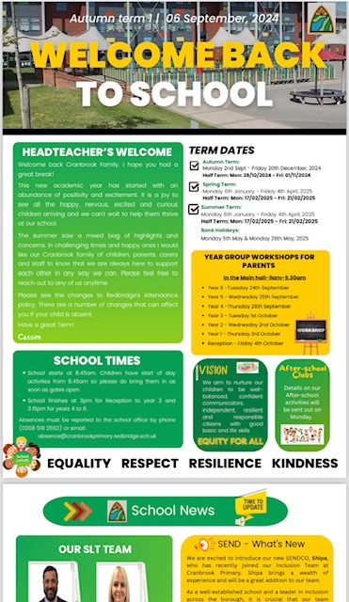
Communication & Partnership
PING App: It’s free for parents to download
You can return and complete letters, forms and payments on-line
Website: www.cranbrookprimaryschool.com
Newsletter – Every half termly
Class emails
recblue@cranbrookprimary.redbridge.sch.uk
recgreen@cranbrookprimary.redbridge.sch.uk
recred@cranbrookprimary.redbridge.sch.uk
recyellow@cranbrookprimary.redbridge.sch.uk
Yvonne

Slide 4
Twinkl phonics
At Cranbrook we develop phonics and early reading skills using TWINKL Phonics. Teachers assess phonics using rigorous assessments to ensure children are developing their segmenting, blending, and decoding skills.
All 1-1 reading books across the school are closely matched to our phonics scheme using Collins BigCat books and Rhino Readers. These books will be selected to match the pupils current phonics level in EYFS. We also use Dandelion Launchers books for some of our beginner and reluctant readers which are also matched closely to our phonics scheme. These books have been selected as they build a child’s self-esteem and encourage confidence in independent reading.
Each unit introduces new letters/sounds while revising previously taught phonic letters/sounds and high-frequency or sight words.
Yvonne

Slide 5
Yvonne

Slide 6
Phonics levels
Level 2: When a child can identify all phonemes taught in Level 2 and can say the sound each one makes. Can identify initial sounds. Can begin to blend, if the child cannot blend yet, they will still be at Level 2.
A child will not be at Level 3 until they can identify all phonemes, digraphs and trigraphs taught at Level 3.
Level 3: When a child can blend CVC words (such as s/u/n) confidently and independently and identify all phonemes, digraphs and trigraphs taught at Level 3 they have achieved this. They should also be able to begin to identify high frequency words for this phase.
Level 4: A child will be able to blend phonemes to read CVC (consonant-vowel-consonant) words, CVCC and CVVC words. They will begin to read polysyllabic words and high frequency words for this Level.
Raquel

Slide 7
Reading at home with your child
Your child’s book is changed once a week unless you have been informed otherwise.
Children need to ensure that they are bringing in their books everyday as we do not give out a set day for when they will be changed.
Parents must comment in their child’s reading diary so we know they have been reading at home.
If your child brings home a book its your responsibility to ensure that book comes back to school.
If a book/reading record does not get returned and is classed as ‘lost’ then there will be a £5 fee to replace the book.
Raquel

Slide 8
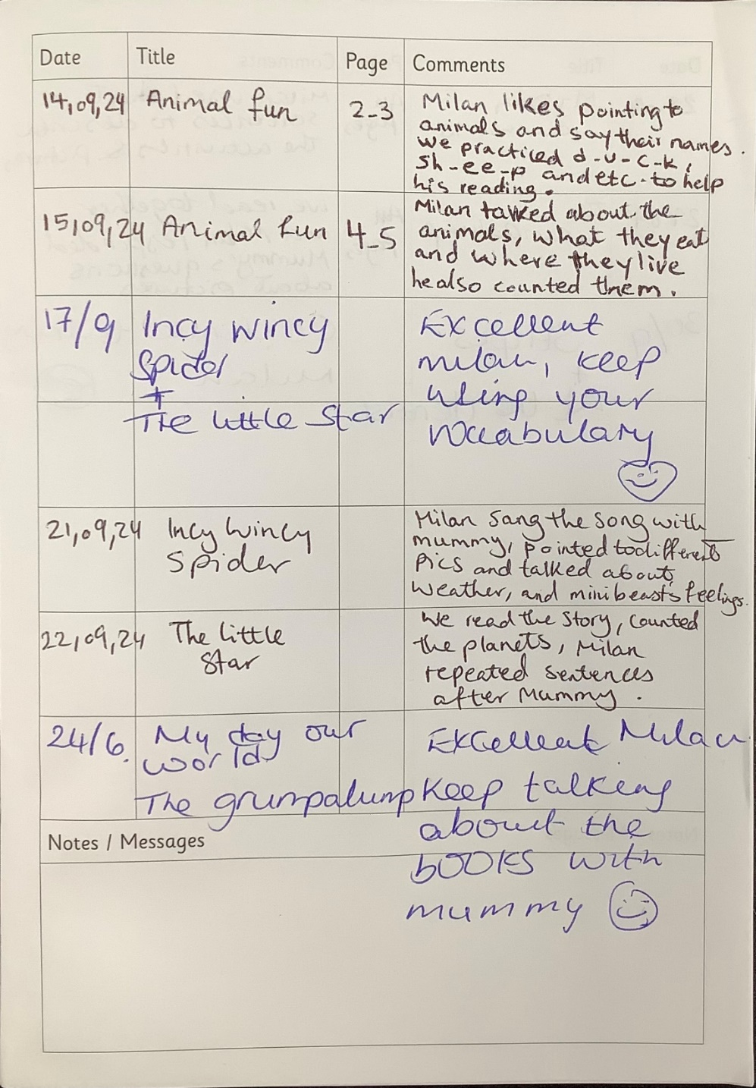
Reading Records
Sukhraj

Slide 9
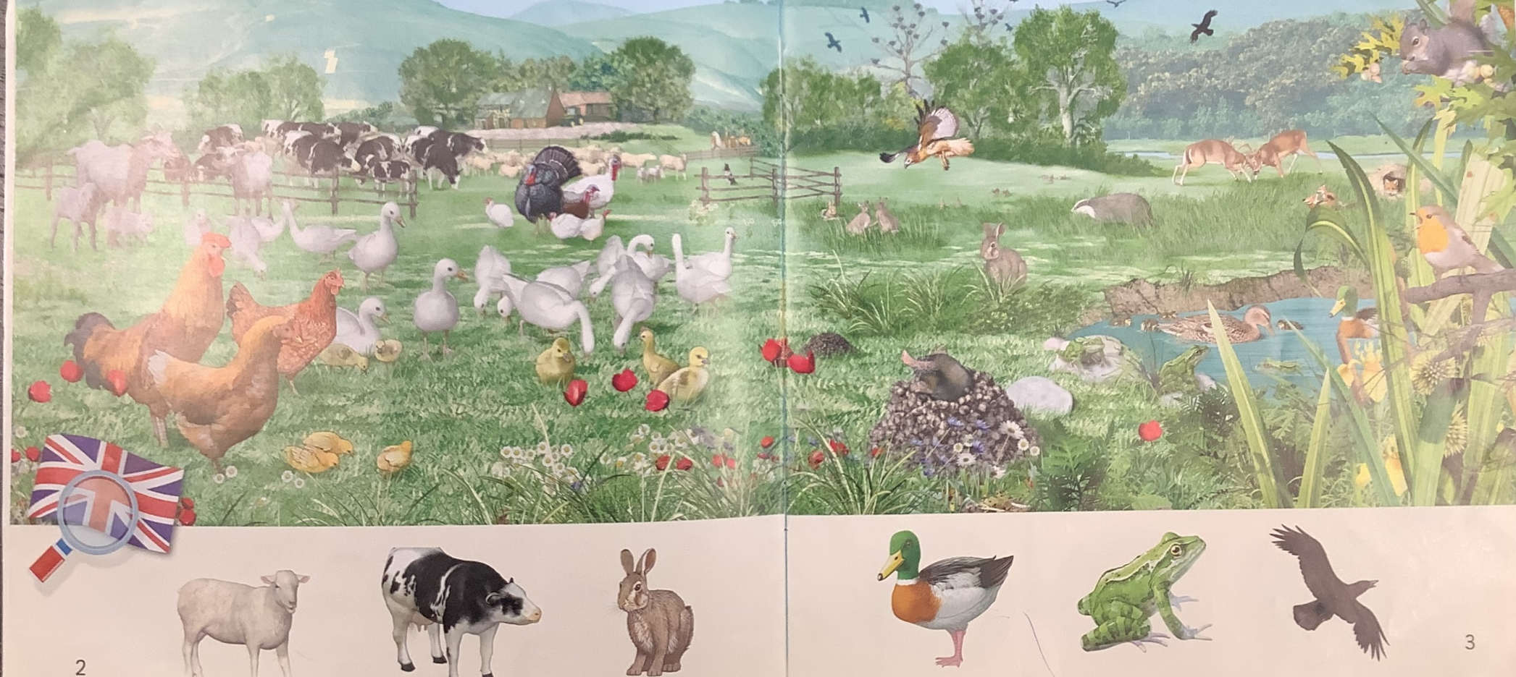
Reading with your child
Sukhraj

Slide 10
Lots of new free online resources to support your child with phonics and handwriting at home
Mr T’s Phonics www.youtube.com/channel/UC7sW4j8p7k9D_qRRMUsGqyw
www.youtube.com/channel/UCg_q6YX1y3DG8Ttu_7mJ12Q
alphablocks www.youtube.com/results?search_query=alphablocks
Level 2 sounds - www.youtube.com/watch?v=0SzkjubQ-Ok
Blending - https://www.cranbrookprimaryschool.com/help-for-reading?wix-vod-video-id=f1b6a7d1f6fa4920888359a1a192e3f3&wix-vod-comp-id=comp-kuwtbvb3
Sukhraj

Slide 11
WYSAR
Wear your slippers and read’ mornings.
The Early Years Foundation Stage underpins all future learning by supporting, promoting and developing children's language, communication, reading and writing.
WYSAR is carried out to promote the love of reading through parental involvement. - Parents and carers are welcome to share the joy of books with their children in school.
WYSAR will take place in your child’s class on Thursday mornings. Please see the newsletter for dates.
When is ‘WYSaR’ Mornings?
Reception: Thursday 8:45 – 9:05
Henna

Slide 12
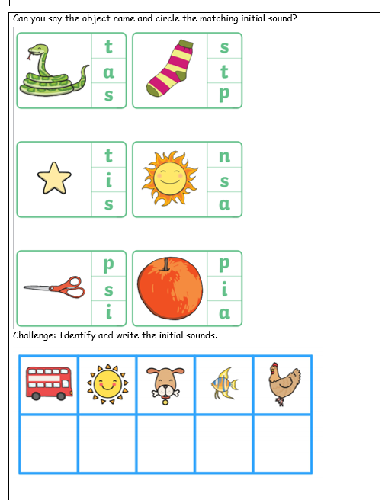
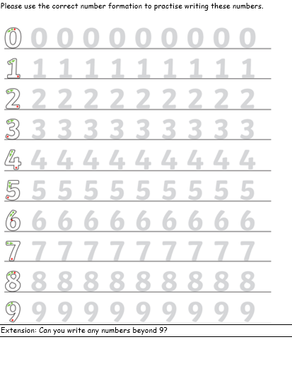
Homework
We will begin to hand out homework after the half term week beginning Monday 4th November 2024.
Homework will based on the learning focused in the class for example phonics or maths.
Henna

Slide 13
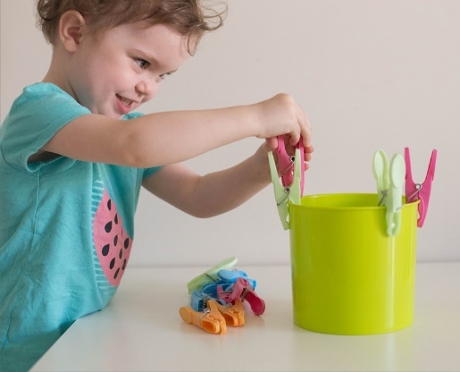
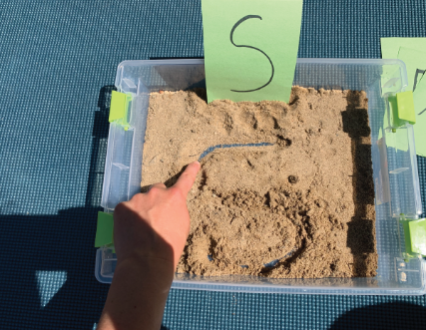
Fine motor skills
In reception we set up lots of opportunities for children to access different activities which help increase their fine motor skills.
This is important because developing fine motor skills help children do things like eating, writing, manipulating objects and getting dressed.
Things you can do at home:
Pouring and Filling with water
Letter hunt
Playdough/Finger painting
Peg Boards
Threading
Squeezing pegs
Henna

Slide 14
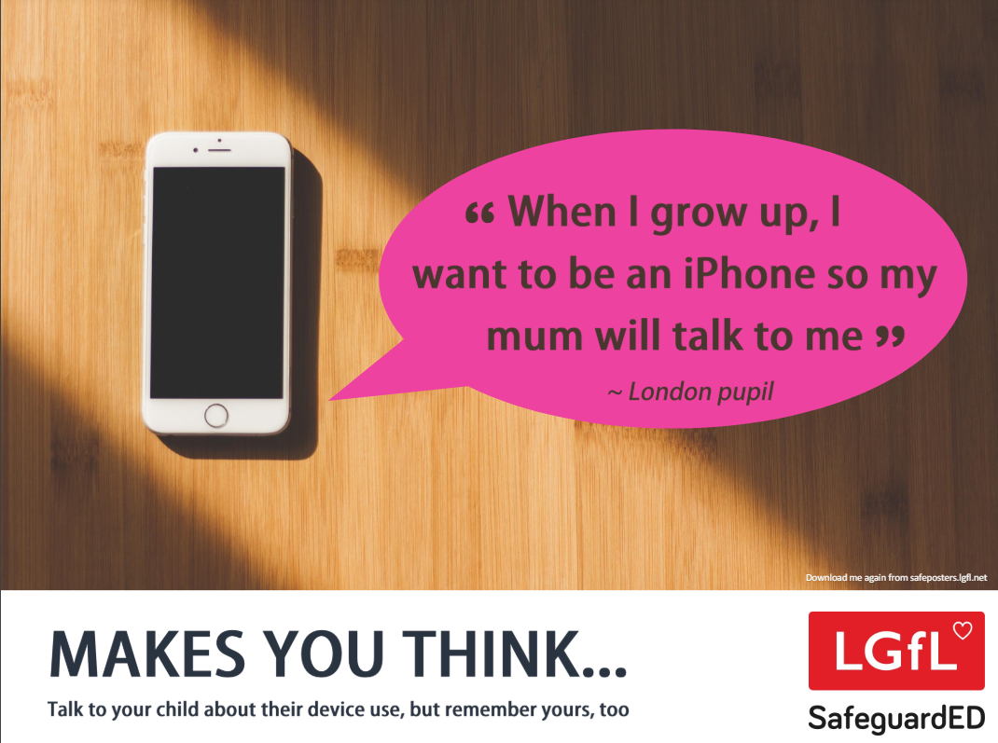
Online Safety
What children in the early years are doing online
Children are now more digitally savvy than ever before. Their use of digital devices is commonplace with apps like YouTube Kids becoming a destination of choice for 72% of children aged 3 to 4 according to a recent Ofcom report.
Research also shows that children are moving away from watching TV, opting for video-on-demand content on video-sharing platforms to watch cartoons, mini movies and songs.
The impact of device use on children’s development in the early years
Ongoing research suggests there are both positive and negative developmental outcomes.
Benefits of screen use include:
Opportunities to promote creativity and learning language development
Improvement of numeracy and literacy skills
Greater understanding of the world
Development of digital skills
Challenges of screen use include:
Impact on children’s ability to control their emotions
Displacement of activities that promote social interactions vital for development
Risk of exposure to inappropriate content
Raquel
Notes:
It can be hard to talk to your children about racism. Some parents worry about exposing their children to issues like racism and discrimination at an early age. Others shy away from talking about something they themselves might not fully understand or don’t feel comfortable discussing. Yet others, especially those who have experienced racism, simply do not have such choices.
Children who encounter racism, can be left feeling lost while trying to understand why they are being treated a certain way, which in turn can impact their long-term development and well-being. It is important to note that communities that are impacted by racism are also able to perpetuate racism too.

Slide 15
Parent contributions
To cover the cost of additional resources in your child's classroom we would appreciate a £6 parent contribution every half term. This will go towards paying for additional resources such as; play dough, cooking, arts & crafts and outdoor resources.
Contributions will be collected by the Class Teacher once every half term.
Please put this in an envelope with your child's name. Thank you for your continuous support.
Raquel

Slide 16
Thank you!
Thank you for your continued support and valuable contributions.

